Slide 1
Dynamic Web Application
Group Members
Akash Suresh - 50195
Aziz Ramazanov - 52708

Slide 2
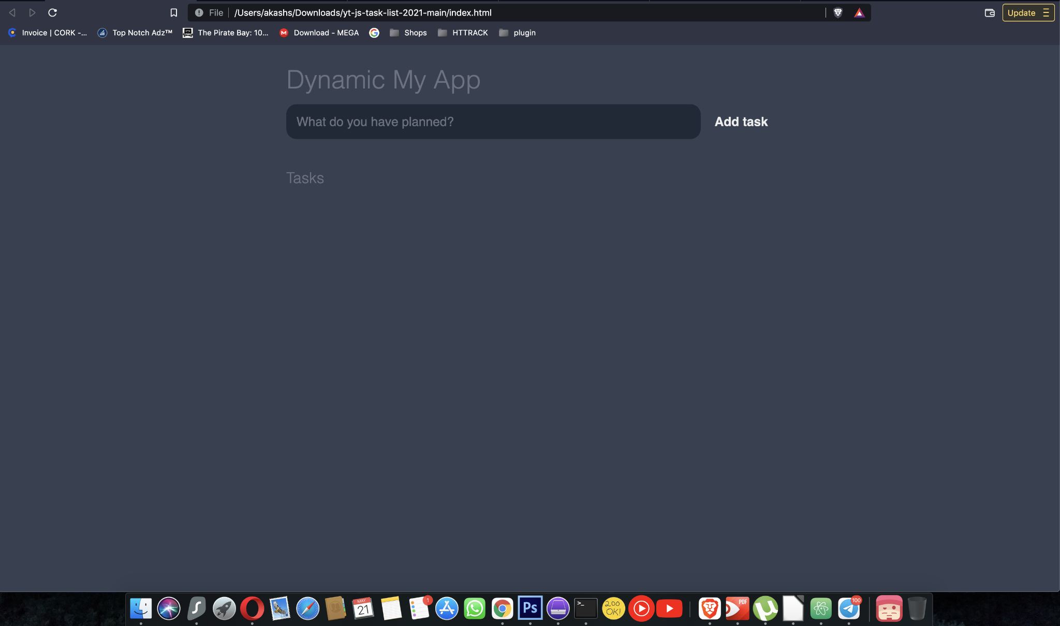

Slide 3
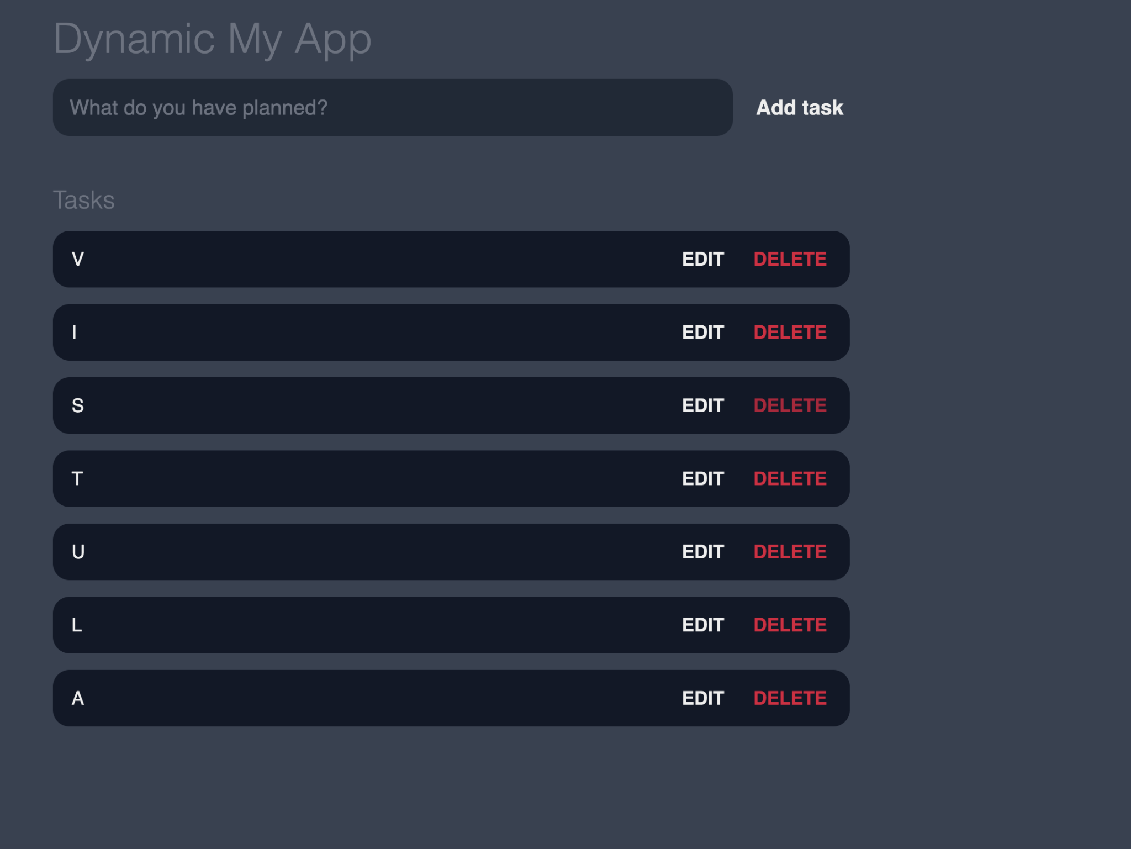
We have created a web app that loads the given to do task and shows it on the home page.

Slide 4
Entering a task and clicking on “add task” stores the string value of the task to our sql database. CSS is used to align & create a design of the app.

Slide 5
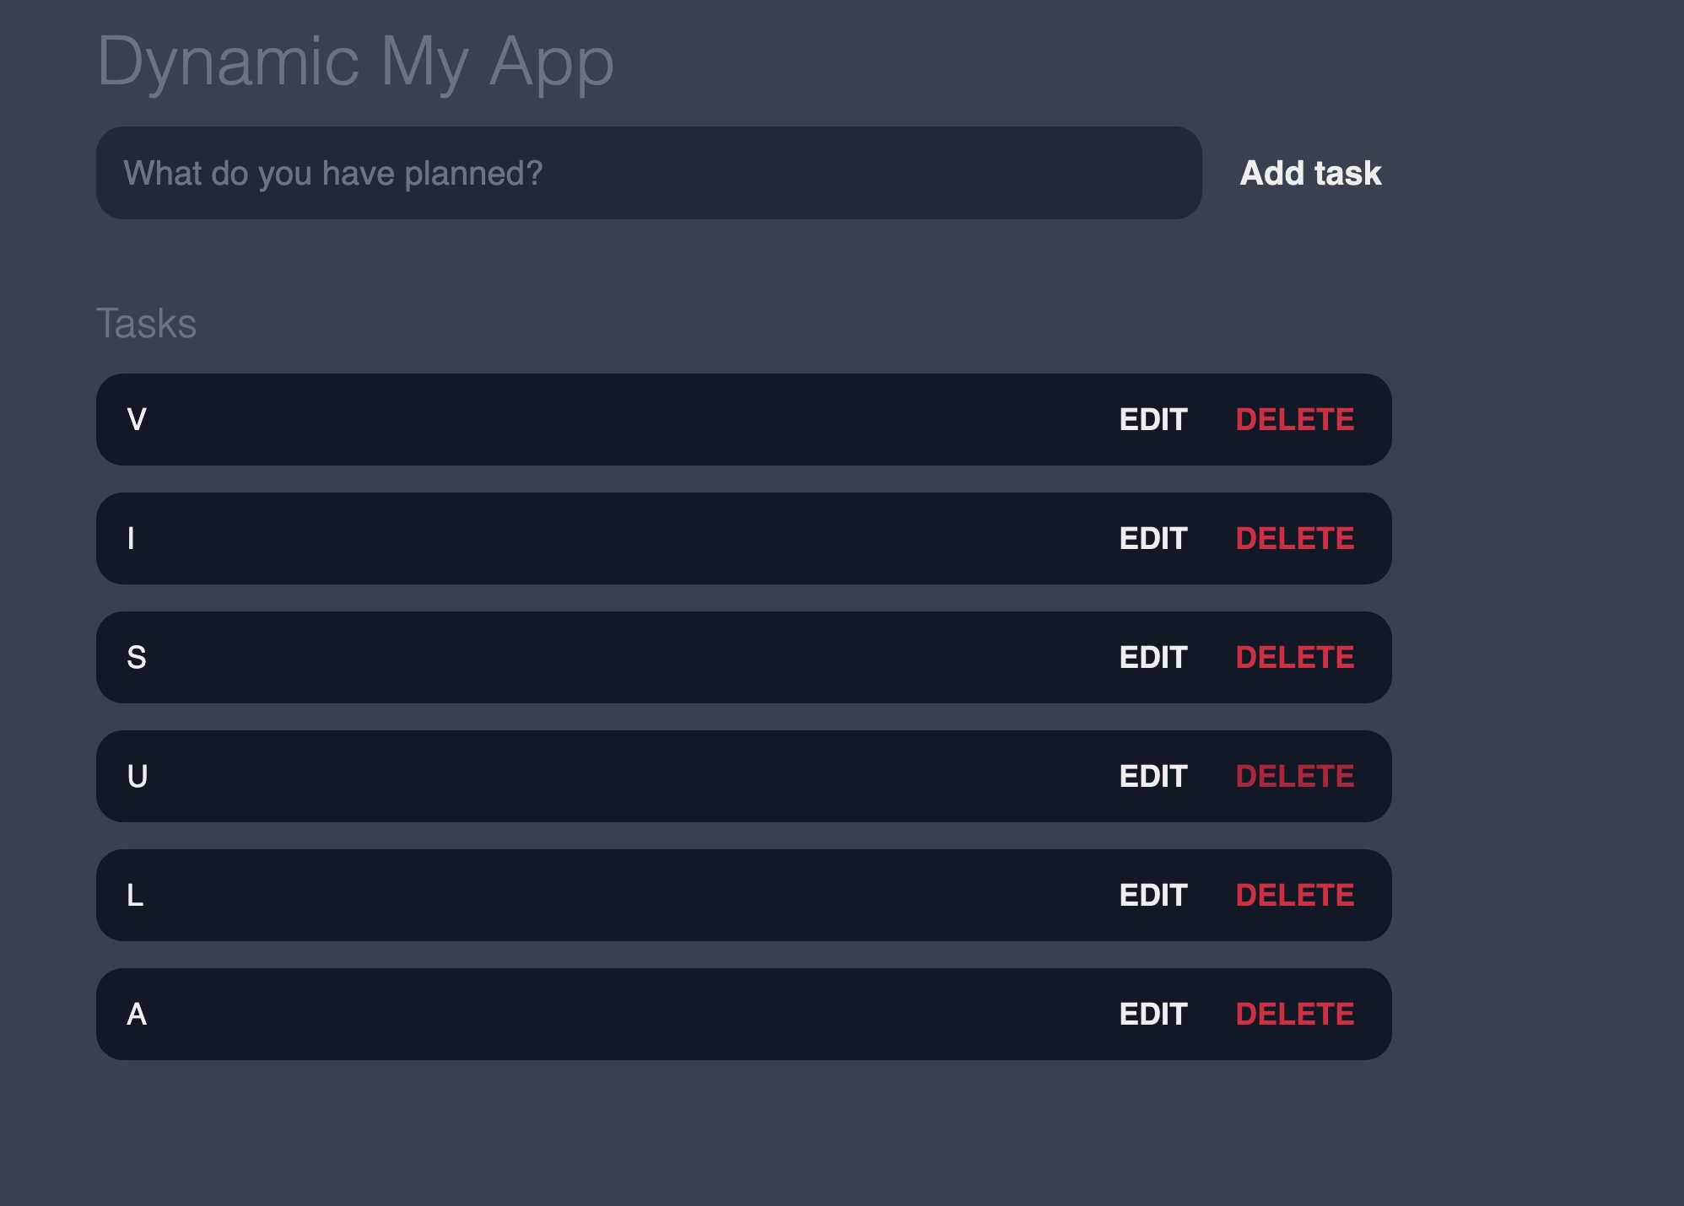
We have also used java for the showing the working functionalities of the to do app.
When users click on “delete”
The task is removed from the list and does not show up on the homescreen.
A small description is also shown at the end of the website.

